Slide 1


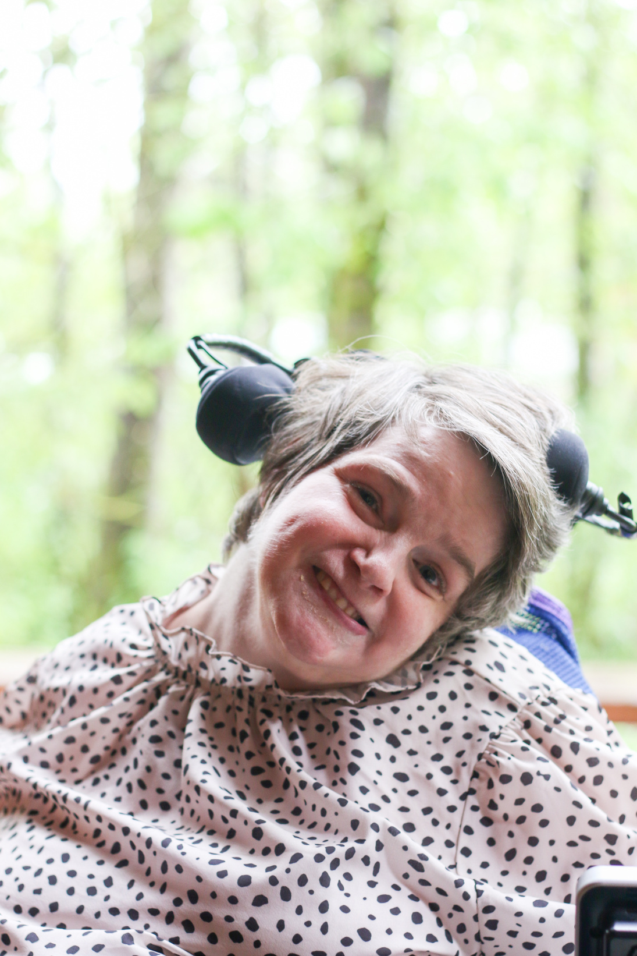
Services and Supports
How can we create more?
Presented by: Julie Clark

Slide 2

About Me
Hi, my name is Julie Clark, and I live in Olympia, Washington. I am the chair of public policy for the Washington State Developmental Disabilities Council. I am here to present on Services and Supports, how can we create more?

Slide 3

What supports and services have made the biggest difference in my life
Being in Kokua Services because they stood by me when I needed them to.
Kokua is a non-profit, residential support agency that serves adults with disabilities in the Thurston County area. Local and dedicated services like Kokua can help improve the lives of people with intellectual and developmental disabilities.

Slide 4
How state cuts affect the services and supports I personally use
The state cuts have affected the services and supports I personally use. For example, I can’t go on overnights anymore and events like Community Summit are not in person this year.
When services and funding get cut, it effects people with I/DD and makes it harder for us to be included in the community.

Slide 5
The services that myself and others need that are currently missing or hard to get in our community
An example of a service I am missing in my community right now is having supports in the community that are trained to use my suction machine. Right now, my caregiver has to go out with me when I leave my home.

Slide 6
What lawmakers and decision makers need to understand about cuts to services like Medicaid
Lawmakers and decision makers need to understand about cuts to services like Medicaid would affect individual's daily lives. For me, I would have to move from my home in my community into an institution. Here is my Medicaid Matters Story on the next slide.

Slide 7

My Medicaid Matters Story:

Slide 8
Barriers faced when trying to access services
A barrier for me is I need a service provider who is trained to work my suction machine so that I can access my community. It is important we have trained service providers that meet the specific needs of individuals. This increases individuals getting out in the community and utilizing services.

Slide 9
The gaps we currently have in services
The gaps we are facing is low amount of caseworkers available and services providers. We need to work with elected officials to improve this.

Slide 10
The strengths in our current services:
The strength in our current services are self-advocates and their voices sharing what is working in services and what is not.

Slide 11





How to create more services:
We can help create more services by advocating to our elected officials to fund DD services. There are many advocacy groups in Washington that help individuals with I/DD and their families use their voice to advocate!
...and more!

Slide 12
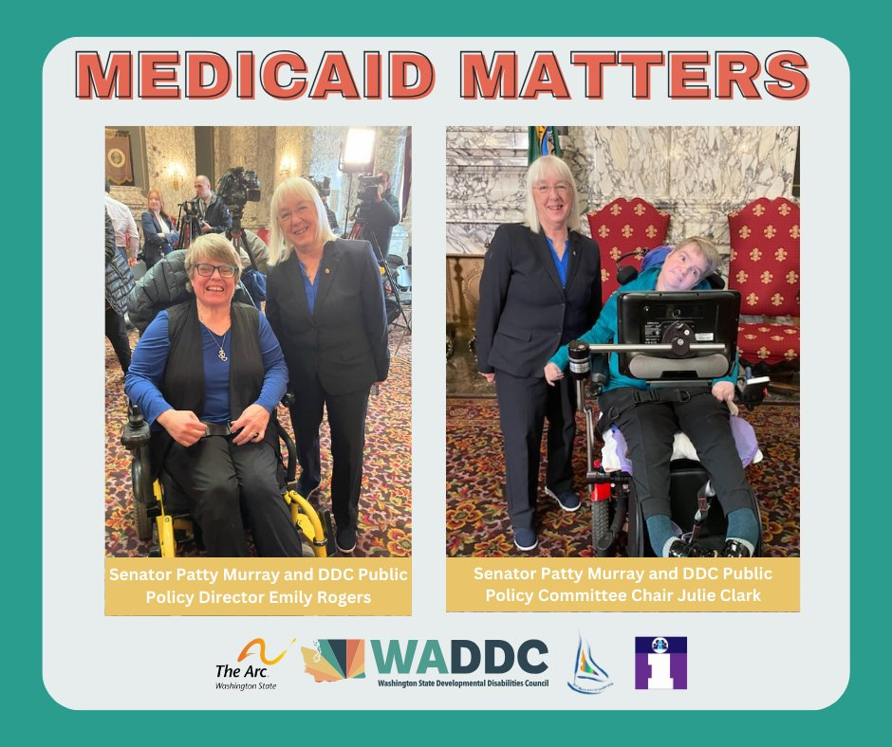

How we can improve the current services we have:
It is important that we advocate and speak to the elected officials about why DD services matter! Joining organizations and reaching out to your elected officials is a great way to help improve the quality of services and create new services.
With Senator Patty Murray!

Slide 13
Let’s Talk!
Now, let’s have a discussion!
What ideas do you have for creating more services in your community?

