Slide 1
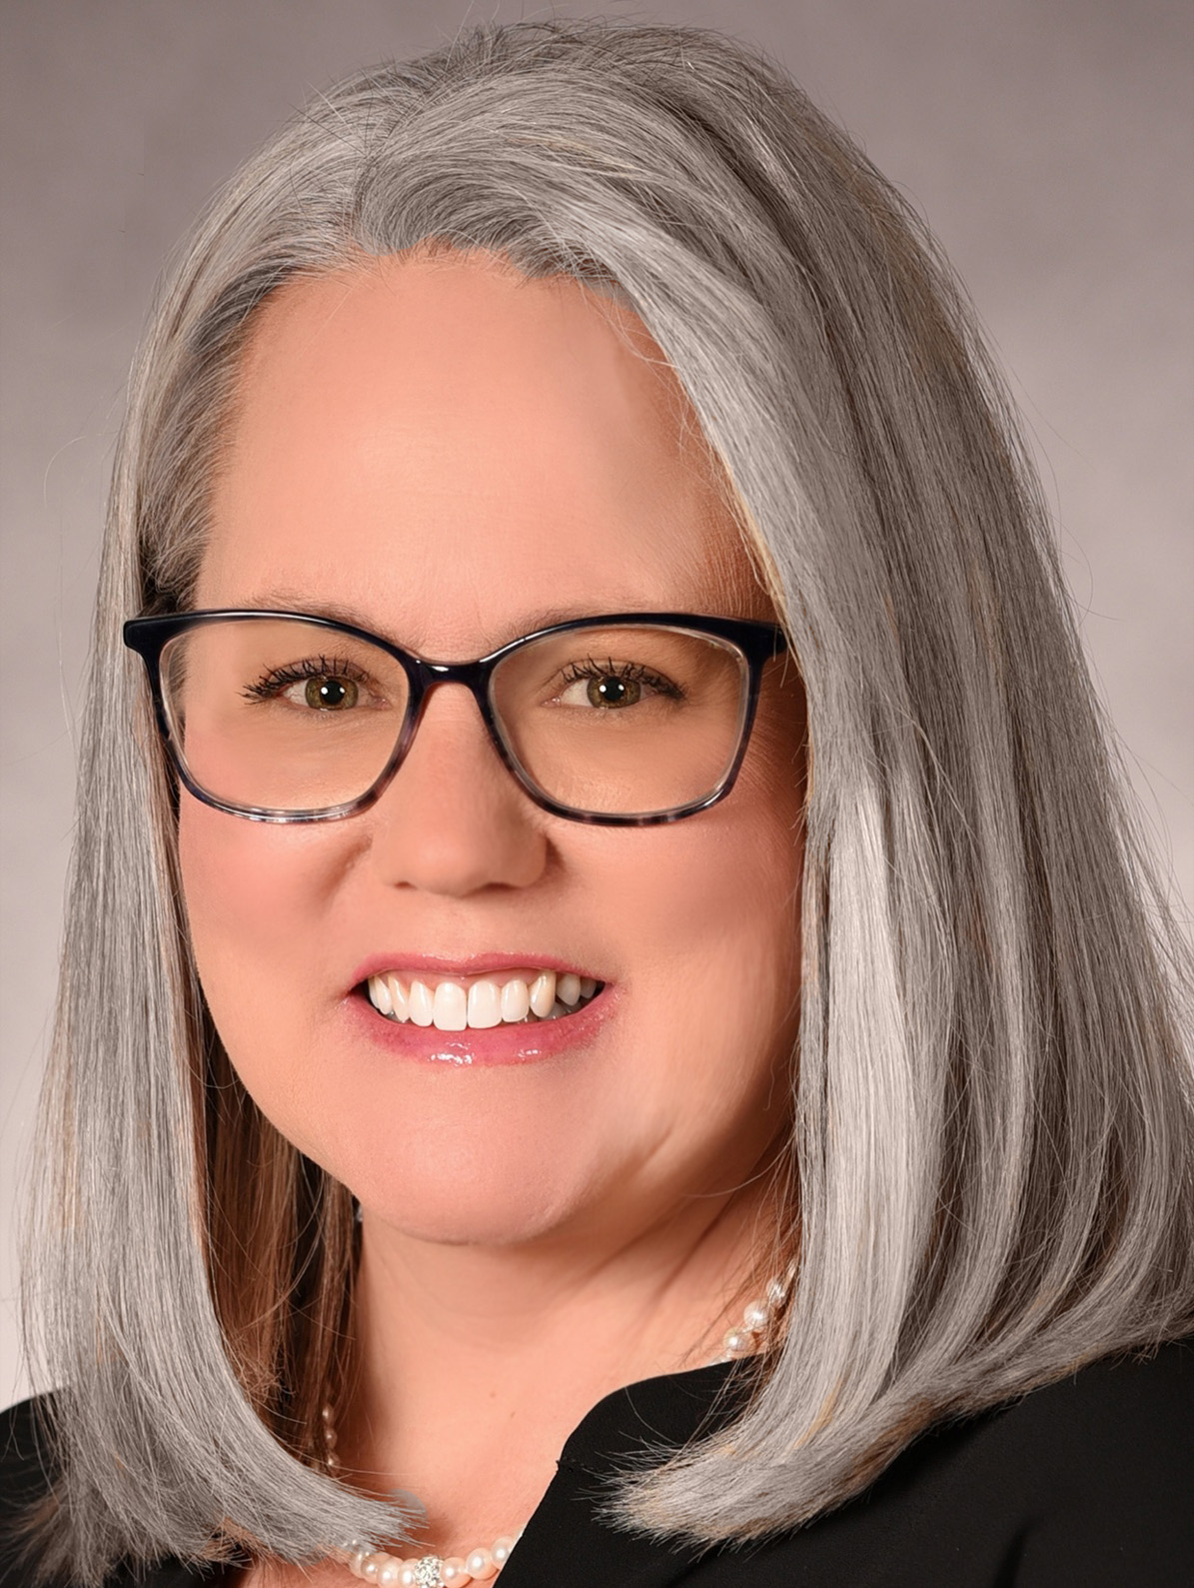
Quality of I/DD Services
Let the discussion begin…
Jeri Plews
DD Contract Adm & Parent to Parent
Okanogan County, WA

Slide 2
Discussion Topics
I/DD Rural Spotlight
What is
I/DD
I/DD Supports & Services
I/DD RURAL Challenges and Barriers
I/DD A New Lens
I/DD
What can we do?

Slide 3

I/DD: DEFINITION & EXAMPLES
There is no single, standard definition of “disability” that is consistently used.
The ADA defines a person with a disability as someone who:
Has a physical or mental impairment that substantially limits one or more major life activities, or
Has a history or record of an impairment (such as cancer that is in remission), or
Is regarded as having such an impairment by others even if the individual does not actually have a disability (such as a person who has scars from a severe burn that does not limit any major life activity).
Cancer
Diabetes
Post-traumatic stress disorder
HIV
Autism
Cerebral palsy
Deafness or hearing loss
Blindness or low vision
Epilepsy
Mobility disabilities such as those requiring the use of a wheelchair, walker, or cane
Intellectual disabilities
Major depressive disorder
Traumatic brain injury
I/DD
is an acronym for intellectual and developmental disability

Slide 4
I/DD RESOURCES
Examples of Supports and Services
Supports and services can start at a very young age and continue for life.
Medical & Dental Appointments (Healthcare, Medicaid/Medicare
Physical, Occupational, Speech, & Cognitive Therapies
Early Intervention & Special Education
Behavioral & Mental Health Care
Community-based (housing)
Child & Adult Care (specialized, day programs)
Financial Assistance (SSDI, SSI)
Individualized Employment and Community Inclusion
Crisis intervention.
Supports and services are crucial for individuals with Intellectual and Developmental Disabilities (I/DD) because they enable them to live more independently, improve their quality of life, and participate fully in their communities. These supports help bridge gaps in skills, address specific needs, and facilitate inclusion, ultimately promoting a sense of belonging and purpose.

Slide 5
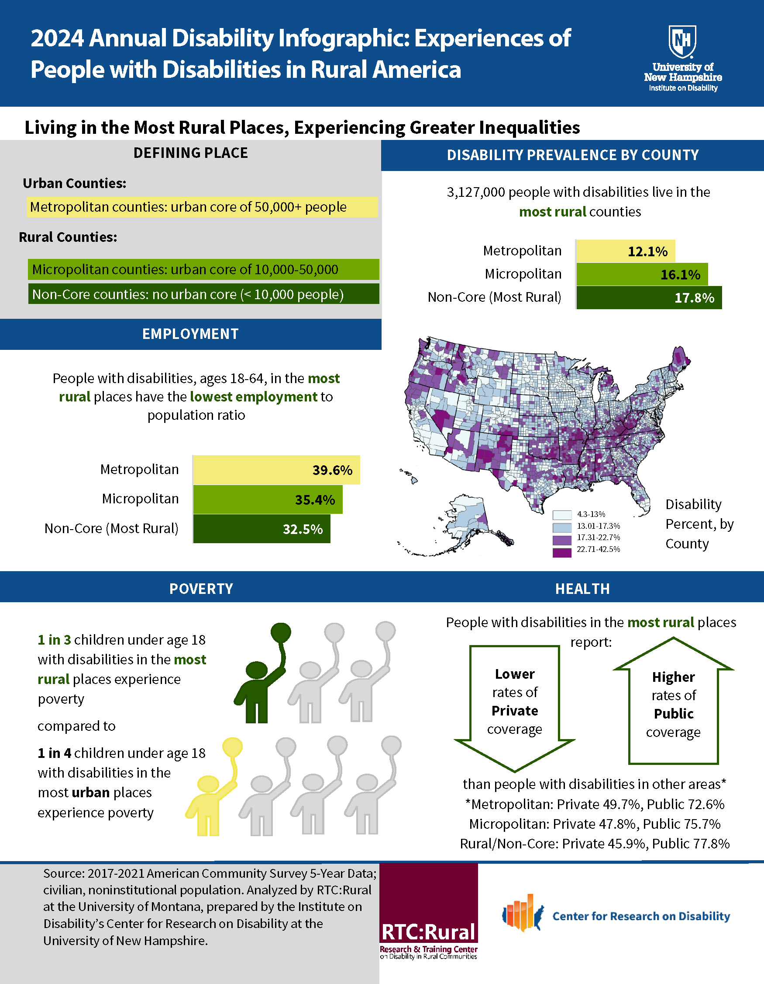
I/DD RURAL SPOTLIGHT
Disability rates are higher in rural areas than urban areas.
WHY?

Slide 6
I/DD RURAL SPOTLIGHT continued
Additional factors:
Poverty & Health

Slide 7
I/DD: SEEKING SERVICES & SUPPORTS
Rural Challenges and Barriers –
I/DD
Location plays a significant role in accessing care
LOCATION
Hours away from supports and services
Lack of TRANSPORTATION
Personal, public, specialized medical
Lack of PROVIDERS
Smaller healthcare workforce
Lack of specialty care
The Struggle
Is REAL

Slide 8
I/DD: SEEKING SERVICES & SUPPORTS
Rural Challenges and Barriers Okanogan County
I/DD
TRUST barriers in the I/DD community can significantly impact access
Social inequality; lack of opportunity, poverty
Economic challenges; struggling businesses
Access to healthcare and education
Lack of resources and awareness
Disasters; WILDFIRE
Closer
to
Home
TRUST! Feeling insecure and isolated! Cultural differences! Communication barriers!

Slide 9
I/DD: Overcoming Challenges and Barriers
A New Lens
I/DD
Location plays a significant role in accessing care

